Slide 1

NodeJS, NPM, Yarn etc.
10. april 2018

Slide 2
Agenda
Node.js
NPM
NuGet
Gulp
Webpack

Slide 3
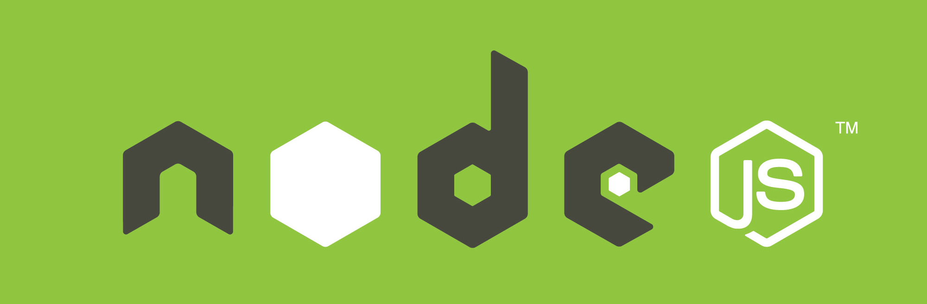
Node.js – Server side JavaScript

Slide 4
What is Node.js
An open-source, cross-platform JavaScript runtime environment
Intended for developing serverside tools and applications
Event driven, works on the Non-Blocking Modell
Used by: GoDaddy, IBM, Microsoft, Paypal
Uses Google V8 JavaScript engine, to compile to native machine code
I.E. it does not interpret it real time (faster)

Slide 5
JavaScript on the Server side
Basically NodeJS allows us to run JavaScript on the backend
Using Google V8
Has a runtime environment and use NPM for dependencies

Slide 6
Where to use NodeJS
Few CPU cycles
I/O operations
Chat/Messaging services
Real-time applications
Communication hubs
High concurrency applications

Slide 7
Where not to use NodeJS
Heavy computation
Large and complicated web applications

Slide 8
That’s it!
No more information on Node.js
Had to be mentioned because NPM runs on Node.js
Please go to https://nodejs.org and download NodeJS LTS version

Slide 9

Node Package Manager

Slide 10
What is NPM
Default package manager for Node.js
It allows users to consume and distribute JavaScript modules
Packages on NPM are in CommonJS format and include a metadata file in JSON format
Over 280,000 packages are available
Created by Isaac Z. Schlueter
Free and open-source!

Slide 11
Usage
NPM can handle project specific dependencies
Likewise it can handle globally installed modules
Project specific modules are saved in node_modules folder
Is normally used from commandline (Visual Studio handles it for us)
Modules for a project are managed through Package.json

Slide 12
Understanding package.json
It is a valid JSON object
Name and Version fields are required
The combination makes a unique identifier for a given package
Other fields
Description
Keywords
Homepage
Bugs
License
Author and contributors
Dependencies

Slide 13
Example: Package.json
{
"name": "ASSIGNMENTONE", // Project name
"version": "0.0.1", // Version number
"description": "Webpack + ASP.NET MVC 4 sample for ReactJS.NET",
"author": "Nicolai Oksen", // Who made it
"license": "BSD", // Which opensource license applies
"devDependencies": { // Development dependencies
"gulp": "^3.9.1",
"gulp-concat": "^2.6.1",
"gulp-uglify": "^2.1.0",
},
"dependencies": { // Dependencies for project
"react": "^15.4.2",
...
}
}

Slide 14
Where to find packages?
https://npmjs.org

Slide 15
Installing packages
Npm is installed together with NodeJS
To install packages, you have to use a Command Line Interface (CLI)
Packages can be installed on a per project basis or globally
Global packages are available globally

Slide 16
Example: Command line
// Install module into node_modules folder. No entry in Package.json
npm install react
// Install module and save dependency in Package.json dependencies
npm install --save react
// Install mdole and save dependency in package.json under devDependencies
npm install --save-dev react
// Install module globally
npm install --global react

Slide 17
NPM alternative
Yarn! ☺
https://yarnpkg.com/lang/en/docs/install/

Slide 18
Example: Visual Studio Code
Notes:
Show all steps in VSCode
Make Package.json
Install React
Show node_modules folder

Slide 19
Exercise time → Open code example for this Lesson (7) → Open the whole folder in VS Code → Open package.json file → Go through the file → Install all packages via command line

Slide 20

Honorable mention: NuGet

Slide 21
What is NuGet
Free and open source package manager
Intended for the Microsoft Development platform
Comes pre-installed on Visual Studio 2012 and above
Supports the .NET Framework and C++

Slide 22
Usage
Demo time...

Slide 23

Gulp Javascript Task Runner

Slide 24
What is Gulp
An open-source JavaScript toolkit
A streaming build system in front-end web development.
It is a task runner
It is built on Node.js and Node Package Manager (npm)
Used for automation of time-consuming and repetitive tasks
Focuses on ”Code-over-configuration”
Has over 300 plugins

Slide 25
Usage
Gulp is run from the command line
When using Visual Studio it is possible to use the Task Runner Explorer tab
It requires a package.json and a gulpfile.js in the root directory
All necessary gulp plugins should be installed into ”devDependencies” in package.json

Slide 26
The gulpfile.js - Plugins
All required plugins are required at the top:
var gulp = require('gulp');
var util = require('gulp-util');
Or like this
var gulp = require('gulp'),
util = require('gulp-util');

Slide 27
The gulpfile.js - Tasks
Tasks can then be created.
First parameter is the name and second is a function
gulp.task('taskName1', function () {
//do something
});
Tasks can aslo perform several predefined function calls
function fn1() {…}
function fn2() {…}
// Task with array of function names
gulp.task('taskName2', ['fn1', 'fn2']);

Slide 28
The gulpfile.js – Default task
Should be at the end of the gulpfile.js
Can be run by typing ”gulp” in the command line
gulp.task('default', [‘taskName1', ‘taskName2']);

Slide 29
Example: Gulp task
Task that handles the bundling of react for my project
gulp.task('scripts', function () {
return browserify()
.external(dependencies) // Load dependencies from node_modules
.bundle() // Bundles them together
.on('error', handleErrors) // Uses a function if something fails
.pipe(source('main.js')) // Creates a new file called main.js
.pipe(gulp.dest('./wwwroot/build/')); // Outputs it to directory
});

Slide 30
Example: Gulp Watch Task
Monitors directories and files for changes. Acts accordingly.
gulp.task('watch', function () {
// libs task runs when changes occurs
gulp.watch('package.json', ['libs']);
// Monitors the src folder
// scripts task runs when changes occurs
gulp.watch('src/**', ['scripts']);
});

Slide 31
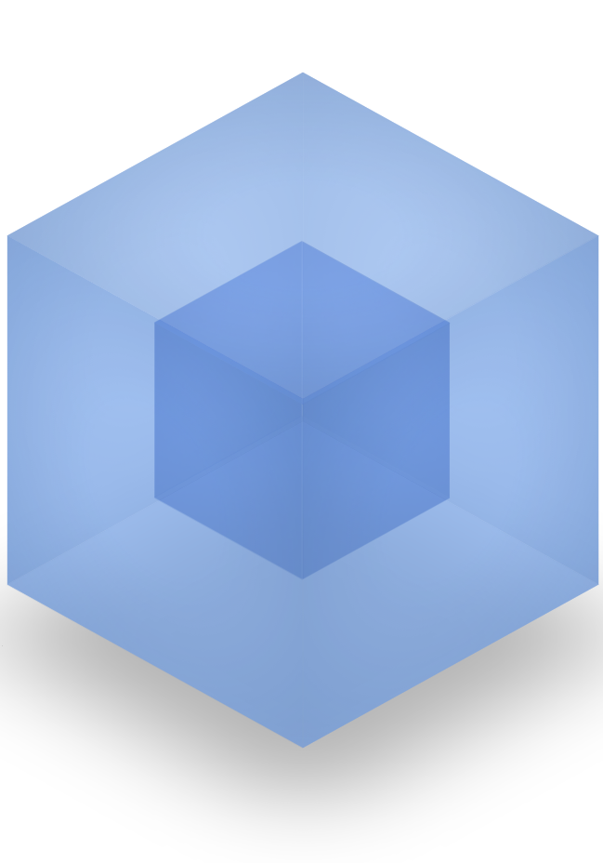
Webpack Module bundler

Slide 32
What is webpack
It is a module bundler
Intended to allow big projects to function better
Ability to customize nearly every part of the module bundler
Ability to integrate 3rd-party libraries as modules
Keep initial loading time low
Every static asset should be able to be a module

Slide 33
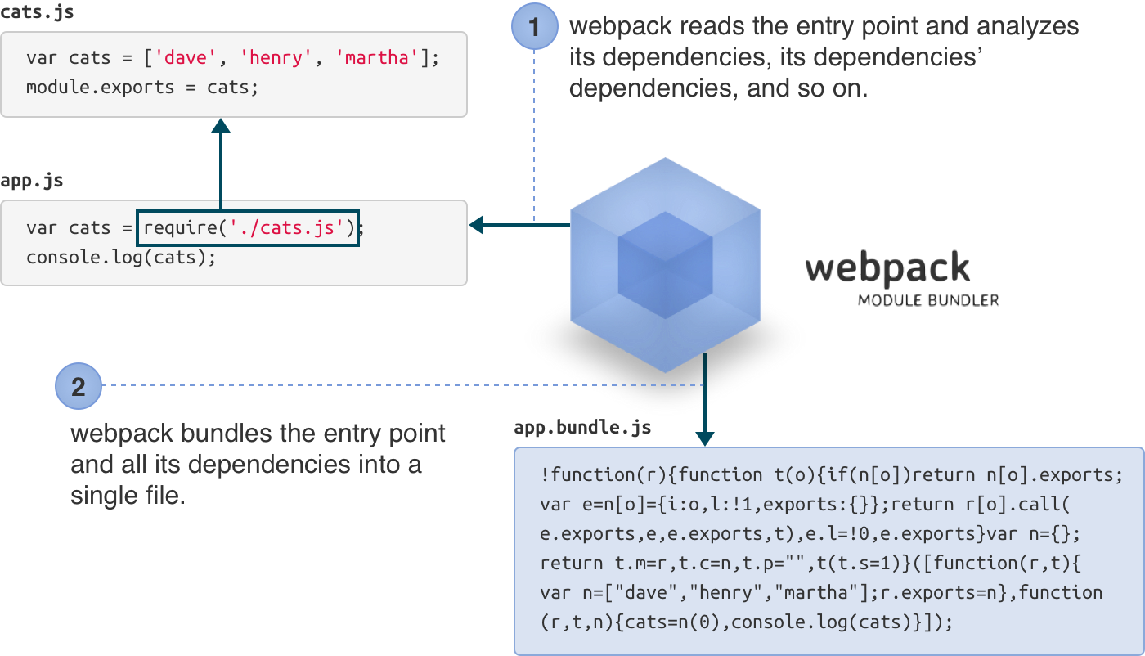
Usage

Slide 34
Usage (cont.)
// cats.js <-- File
var cats = ['dave', 'henry', 'martha'];
module.exports = cats;
// App.js <-- File
cats = require('./cats.js');
console.log(cats);
// Command line
webpack./app.js app.bundle.js

Slide 35
Webpack.config.js
The most basic webpack configuration file:
module.exports = {
entry: './src/app.js',
output: {
path: './js',
filename: 'app.bundle.js'
}
};

Slide 36
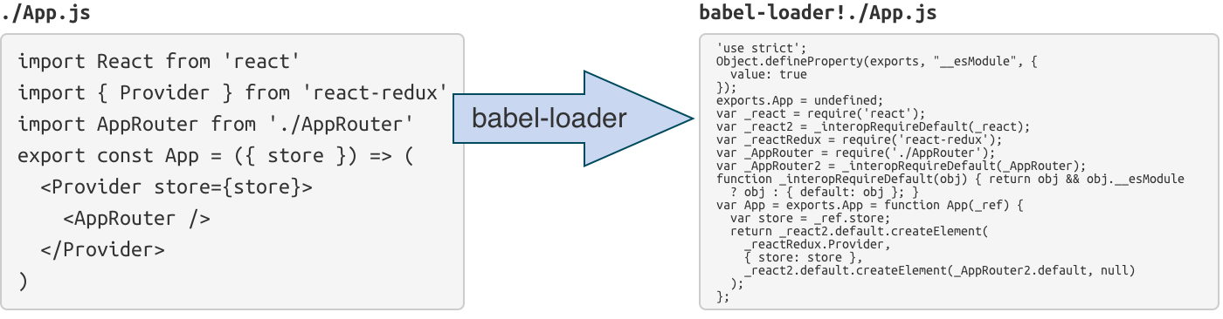
Webpack loaders
Initially webpack only supports JavaScript
Loaders allows support for multiple other things such as TypeScript, JSON etc.
This allows us to use ECMAScript 2015!

Slide 37
Webpack loaders (cont.)
module: {
loaders: [{
test: /\.js$/,
exclude: /node_modules/,
loader: 'babel-loader'
}]
}
We exclude node_modules!
Notes:
Use a loader called Babel.
Test → Find all .js files.
Exclude → everything in node_modules

Slide 38
Using babel-loader allows:
Specific imports
import React, {Component, PropTypes} from 'react'
import Login from './Login'
import Copyright from './Copyright'

Slide 39
And…
class Login extends Component {
render () {
...
)
}
}

Slide 40
ES6 Features
Arrow functions
Classes
Template Strings
Destructuring
Collection spreading
Let + Const
…
Read more: https://github.com/lukehoban/es6features

Slide 41
Code Splitting
Split the dependency tree into smaller chunks and load on demand
As opposed to loading everything up front
Code splitting helps in reducing
Load time
HTTP Requests
When using HTTP/2, chunk size is also a factor
Optimizing the files to avoid code redundancies

Slide 42
Profiling
WebPack also allows for profiling
Basically analysing code and runtime for problem etc.

Slide 43
Multiple entrypoints
Multiple entry point allows webpack to create multiple bundles at once.

Slide 44
Hot Module Replacement
HMR is a way of exchanging modules in a running application
Both adding and removing
Allows updating changed modules without a full page reload
HMR has to enabled explicitly

Slide 45
Using webpack example
Visual Studio guide! :D

Slide 46

Getting setup fast

Slide 47
Now you have some insight into how the different systems work.
Now for how to getting up and running in a jiffy! ☺

Slide 48
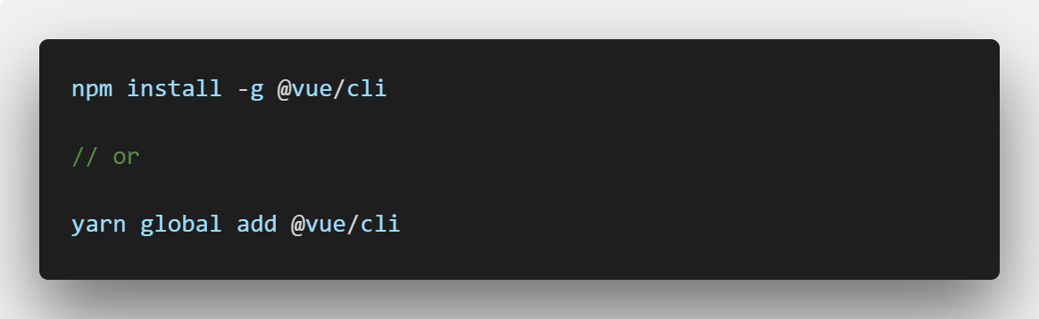
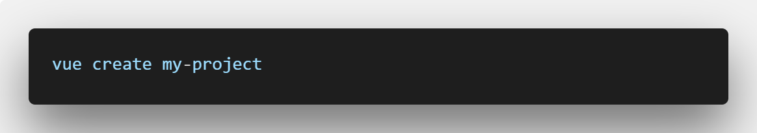
VueJS
Go to a command line
Afterwards run

Slide 49
Vue CLI Demo time
Notes:
Run yarn global add @vue/cli
Run vue create my-project

Slide 50
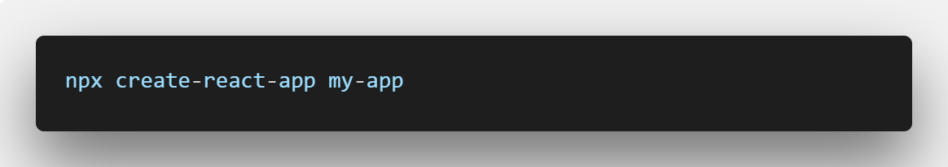
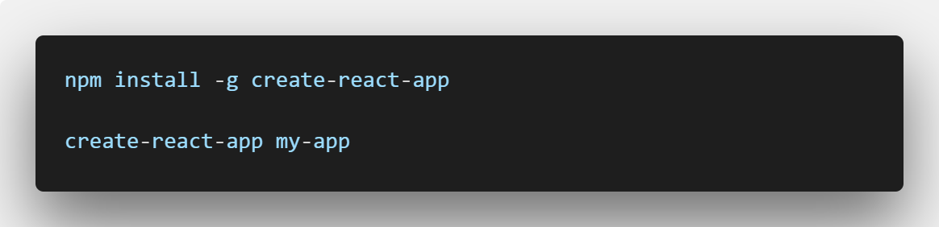
ReactJS
Go to a command line
If you have a space in your user name on windows, use this:
Notes:
Run npm install –g create-react-app
Run create-react-app react-example

Slide 51
Create React App Demo time
Notes:
Run yarn global add @vue/cli
Run vue create my-project

Slide 52
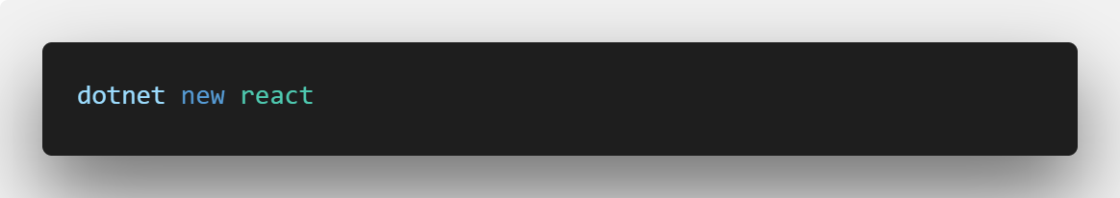
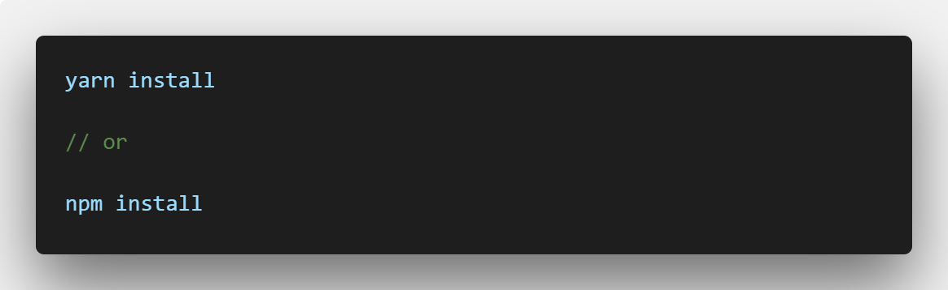
Dotnet
Go to a command line
Then run
Notes:
Run npm install –g create-react-app
Run create-react-app react-example

Slide 53
DotNet CLI Demo time
Notes:
Run yarn global add @vue/cli
Run vue create my-project

Slide 54
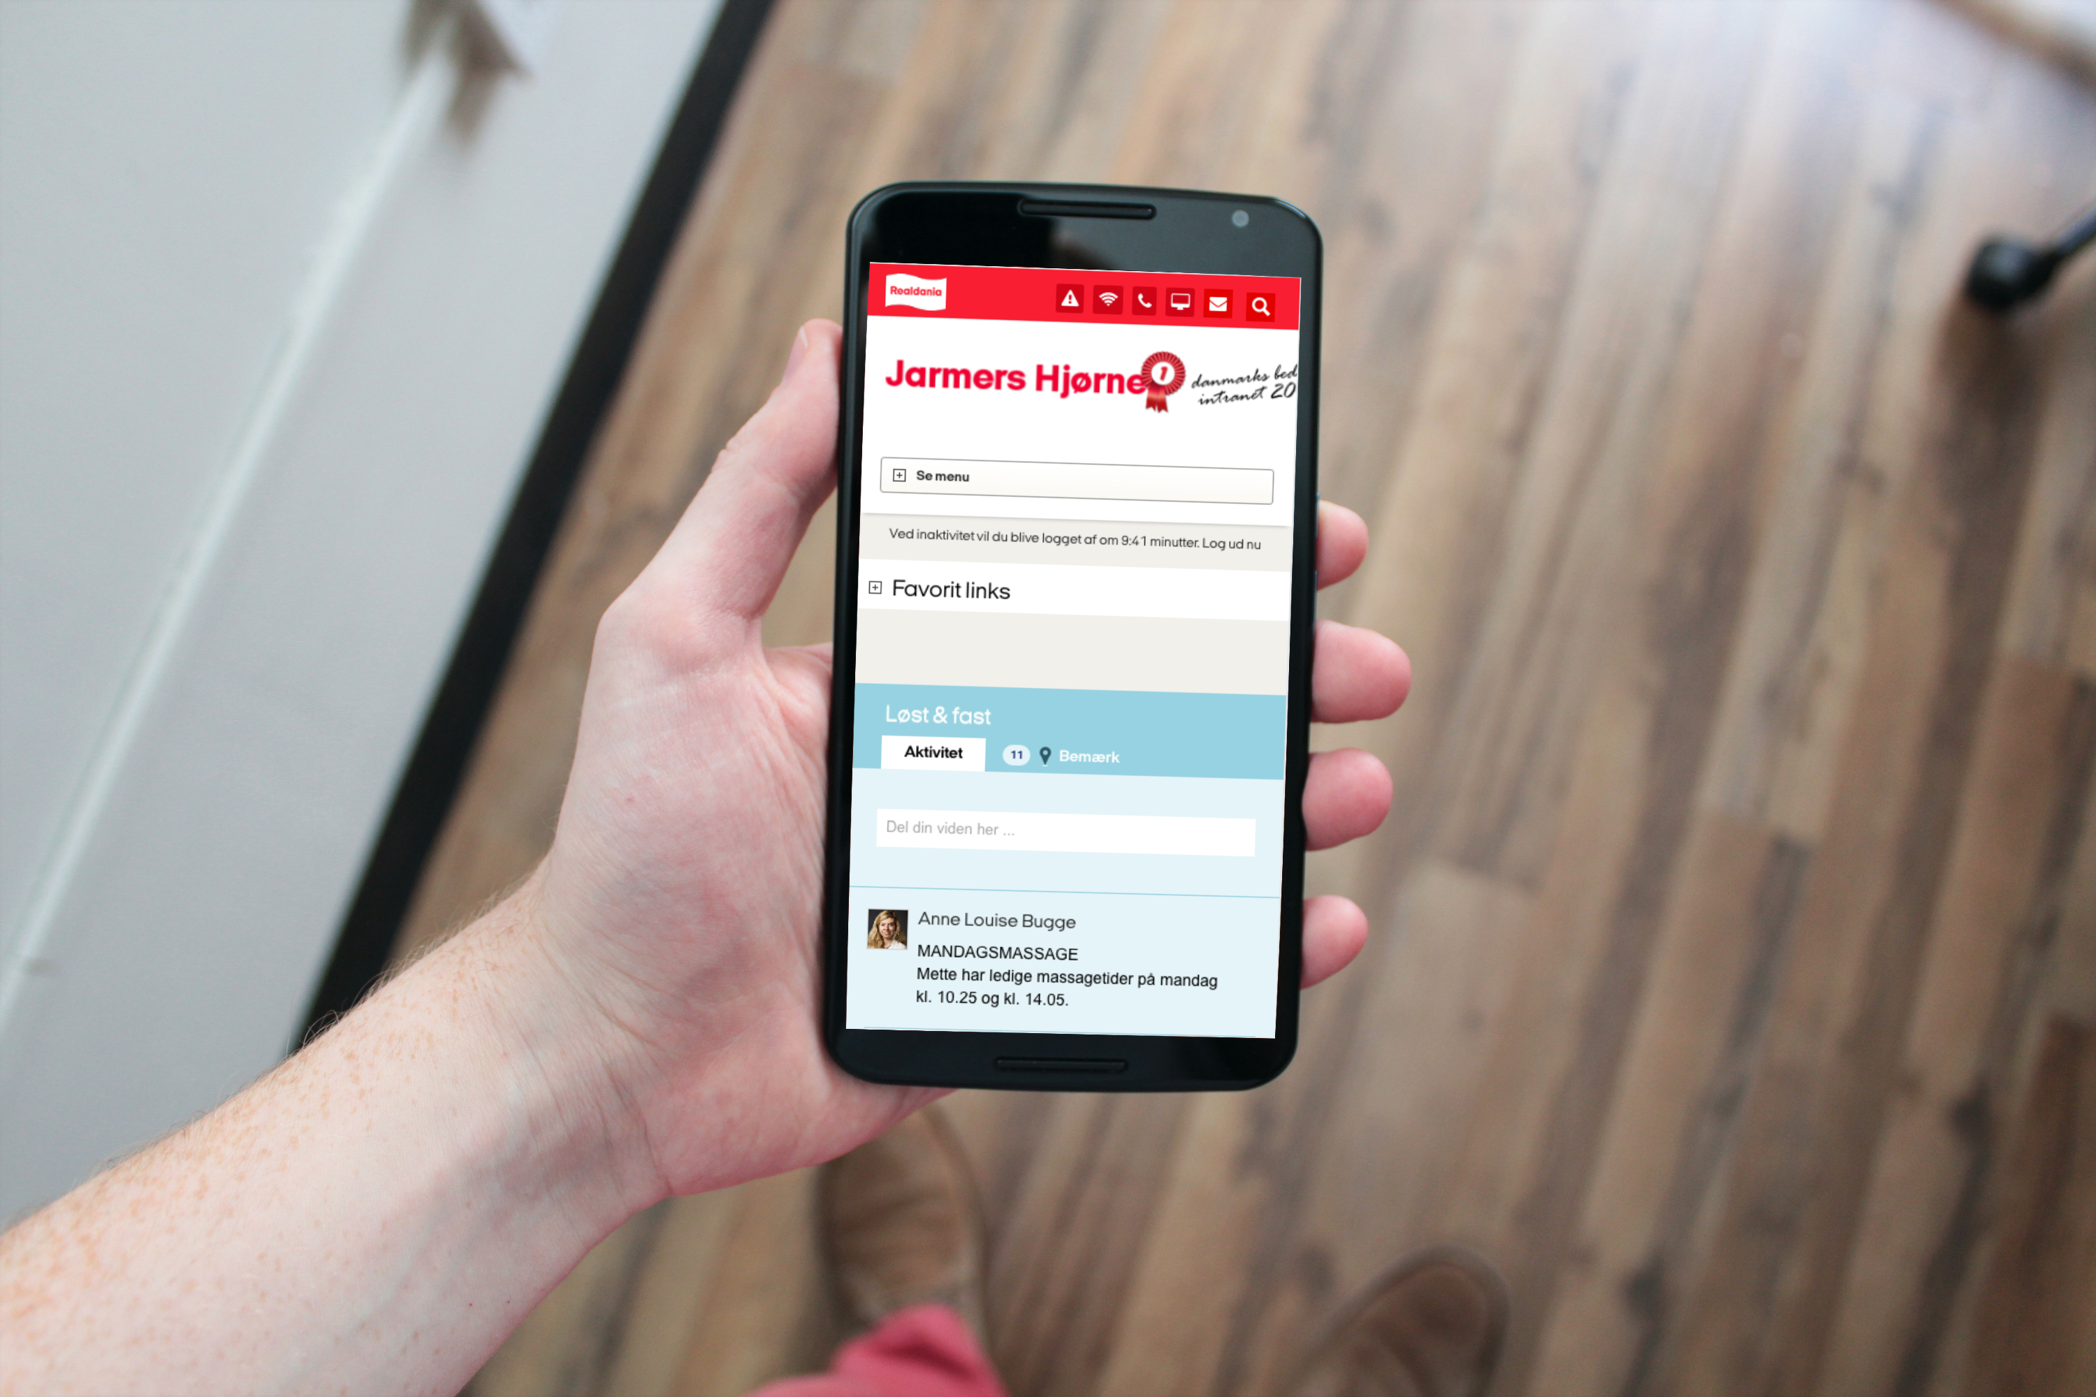
Questions?

Slide 55

Brugbare elementer
Dobbeltklik for at ændre farve eller indsætte baggrundsbillede

